Slide 1
Decision Tree
Decision Tree based Algorithms and Applications
Entropy, Information Gain, Gain Ratio and Gini Index
ID3 vs CART
Example of DT Problem (IG, GI)
Problems and Issues with DT
Dr Azhar Mahmood
Office: EB.1.85 Email: a.mahmood3@uel.ac.uk

Slide 2
DECISION TREES
It is a method that induces concepts from examples (inductive learning)- Specific to General
Most widely used & practical learning method
The learning is supervised: i.e. the classes or categories of the data instances are known.
It represents concepts as decision trees (which can be rewritten as if-then rules)
The target function can be Boolean or discrete valued
Notes:
Specific to General (Inductive)

Slide 3
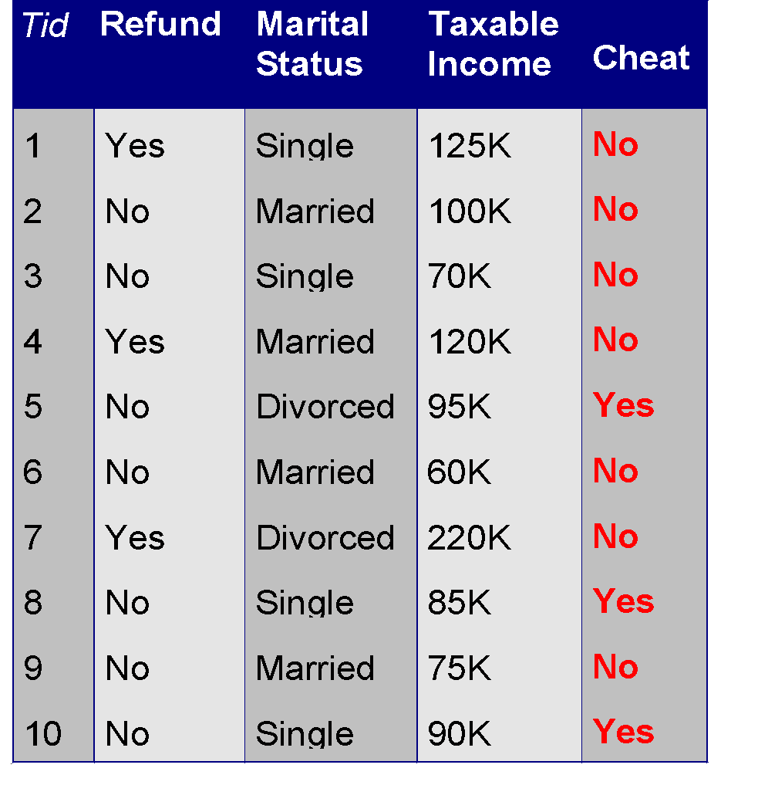
Example of a Decision Tree
categorical
categorical
continuous
class
Splitting Attributes
Refund
Yes
No
NO
MarSt
Single, Divorced
Married
TaxInc
NO
< 80K
> 80K
NO
YES
Training Data
Model: Decision Tree

Slide 4
Another Example of Decision Tree
categorical
categorical
continuous
class
MarSt
Single, Divorced
Married
NO
Refund
Yes
No
NO
TaxInc
< 80K
> 80K
NO
YES
There could be more than one tree that fits the same data!

Slide 5
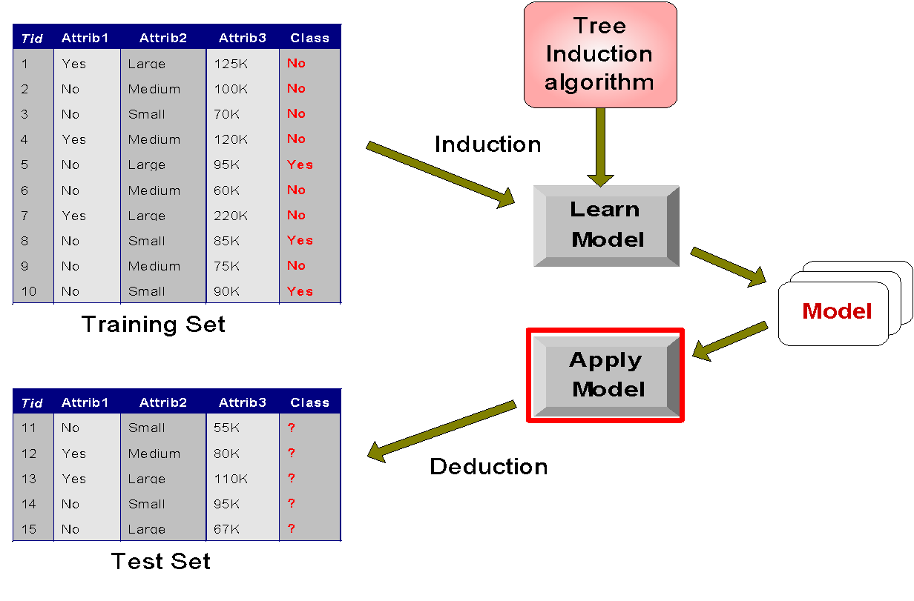
Decision Tree Classification Task
Decision Tree

Slide 6
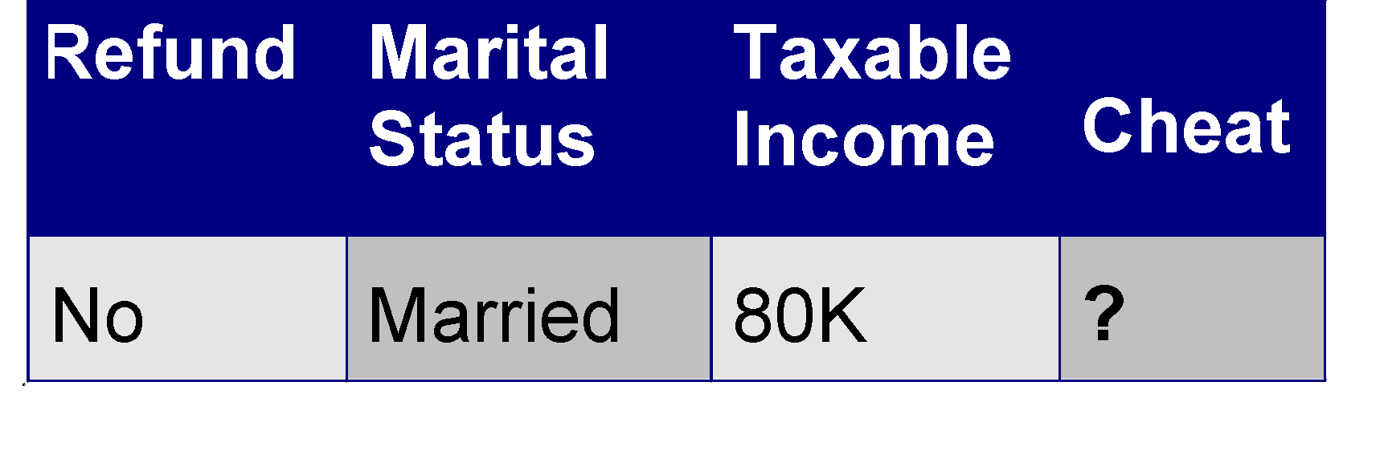
Apply Model to Test Data
Test Data
Start from the root of tree.
Refund
Yes
No
NO
MarSt
Single, Divorced
Married
TaxInc
NO
< 80K
> 80K
NO
YES

Slide 7
Apply Model to Test Data
Test Data
Refund
Yes
No
NO
MarSt
Single, Divorced
Married
TaxInc
NO
< 80K
> 80K
NO
YES

Slide 8
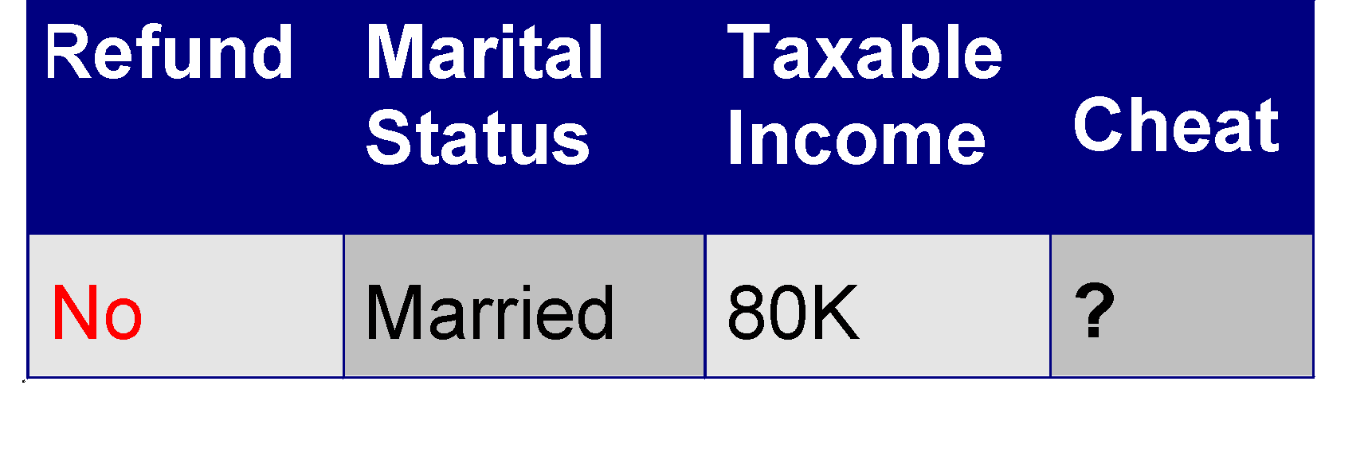
Apply Model to Test Data
Test Data
Refund
Yes
No
NO
MarSt
Single, Divorced
Married
TaxInc
NO
< 80K
> 80K
NO
YES

Slide 9
Apply Model to Test Data
Test Data
Refund
Yes
No
NO
MarSt
Single, Divorced
Married
TaxInc
NO
< 80K
> 80K
NO
YES

Slide 10
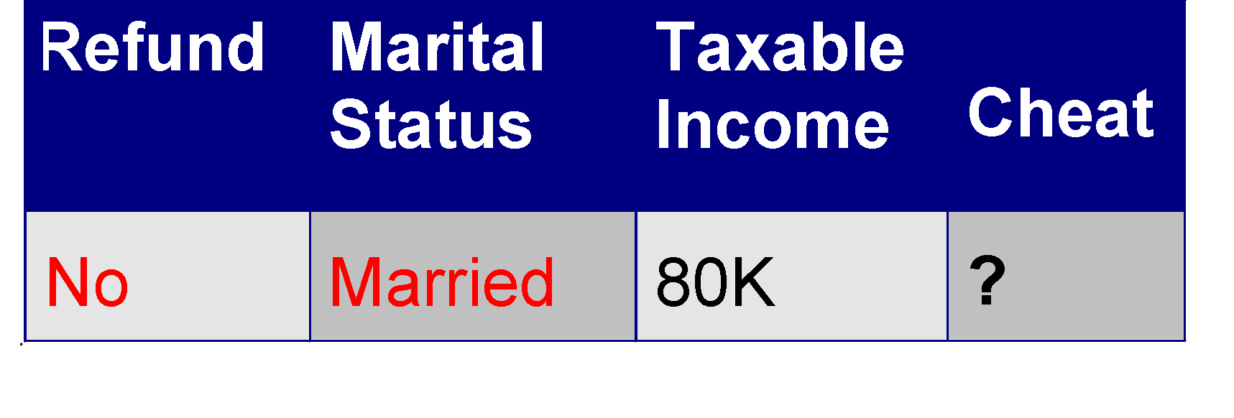
Apply Model to Test Data
Test Data
Refund
Yes
No
NO
MarSt
Single, Divorced
Married
TaxInc
NO
< 80K
> 80K
NO
YES

Slide 11
Apply Model to Test Data
Test Data
Refund
Yes
No
NO
MarSt
Single, Divorced
Married
Assign Cheat to “No”
TaxInc
NO
< 80K
> 80K
NO
YES

Slide 12
DECISION TREES
Decision Tree Representation
It employs a top-down, greedy search through the space of possible decision trees

Slide 13
DECISION TREES
Basic Decision Tree Learning Algorithm
We have
14 observations
4 attributes
  Outlook
  Temperature
  Humidity
  Wind
2 classes (Yes, No)
D12
D11
D1
D2
D5
D10
D4
D6
D3
D14
D8
D9
D7
D13

Slide 14
DECISION TREES
Basic Decision Tree Learning Algorithm
Outlook
Sunny
Rain
Overcast
D10
D6
D1
D8
D3
D14
D4
D11
D12
D9
D2
D7
D5
D13

Slide 15
DECISION TREES
Outlook
Sunny
Rain
Overcast
D10
D6
D1
D8
D3
D14
D4
D11
D12
D9
D2
D7
D5
D13
What is the “best” attribute to test at this point? The possible choices are Temperature, Wind & Humidity

Slide 16
DECISION TREES
Which Attribute is the Best Classifier?: Definition of Entropy
1. Entropy will be 0 if all members of S belong to the same class
2. When the collection contains an equal number of positive and negative examples then entropy will be 1.
3. If the collection contains unequal numbers of positive and negative examples, the entropy is between 0 and 1.
High Entropy means that the examples have more equal probability of occurrence (and therefore not easily predictable), Low Entropy means easy predictability.

Slide 17
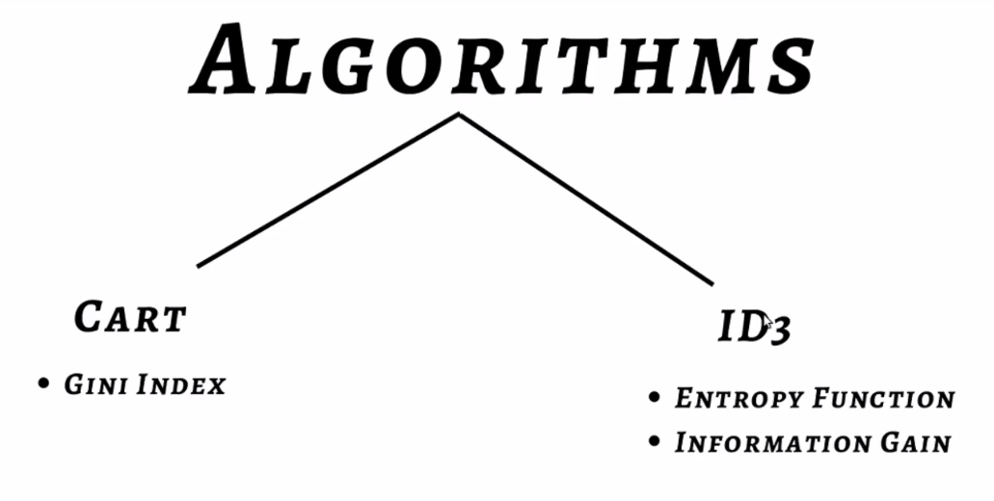
DECISION TREES

Slide 18
DECISION TREES
Which Attribute is the Best Classifier?: Definition of Entropy
In order to define information gain precisely, we begin by defining entropy (Amount of Uncertainty in dataset)
Entropy is a measure commonly used in information theory
Entropy characterizes the impurity of an arbitrary collection of examples
OR
Entropy measures homogeneity of examples

Slide 19
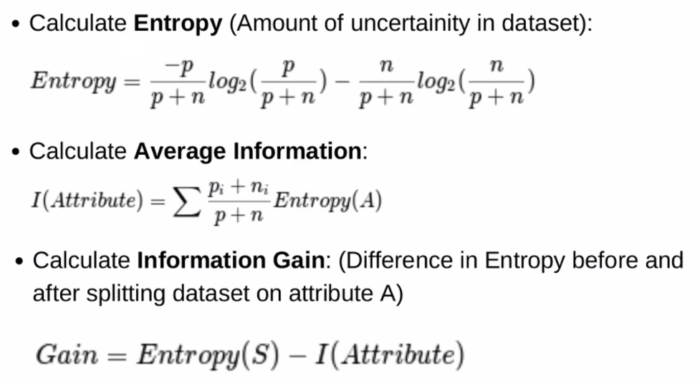
Entropy and Information Gain

Slide 20
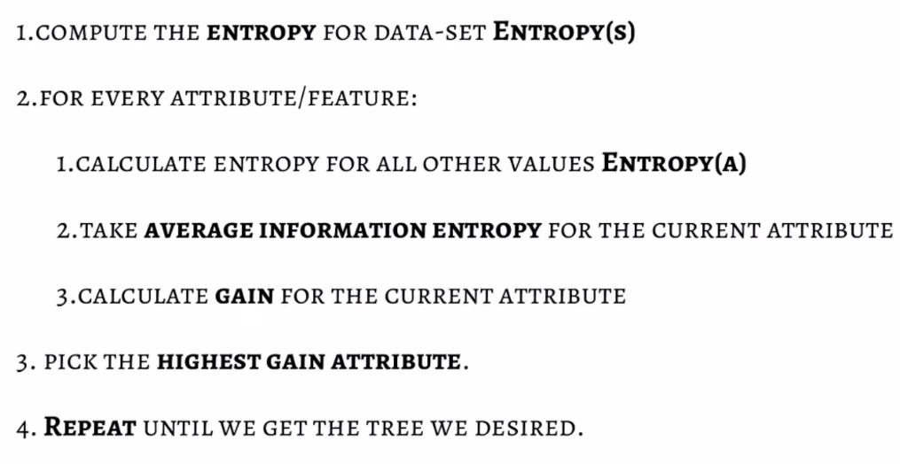
Steps – Decision Trees

Slide 21
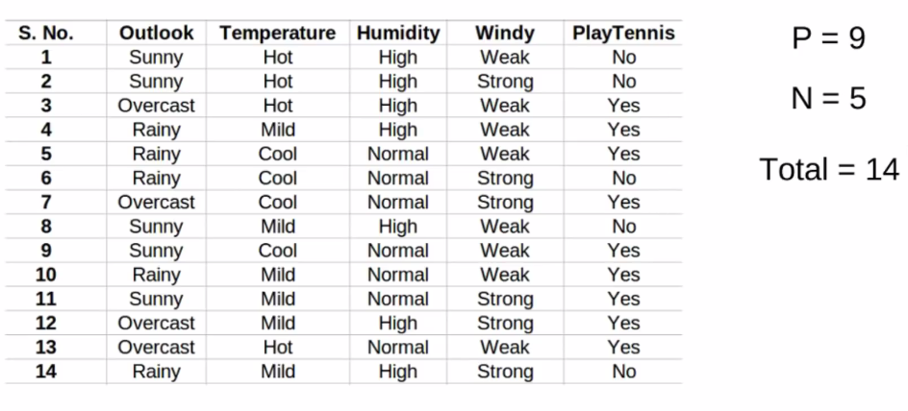
Example- DECISION TREES

Slide 22
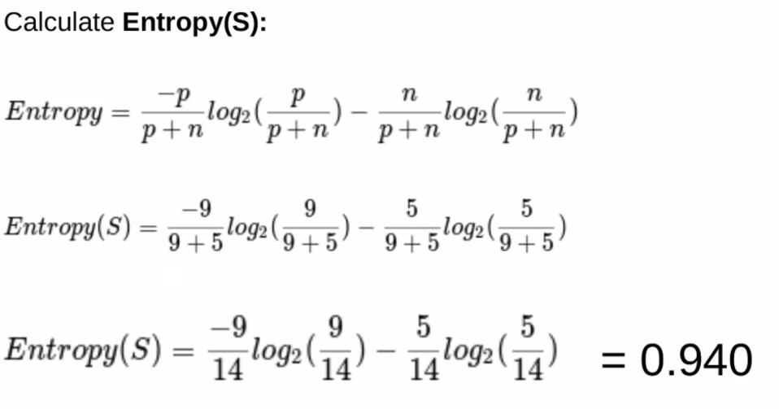
Example- DECISION TREES

Slide 23
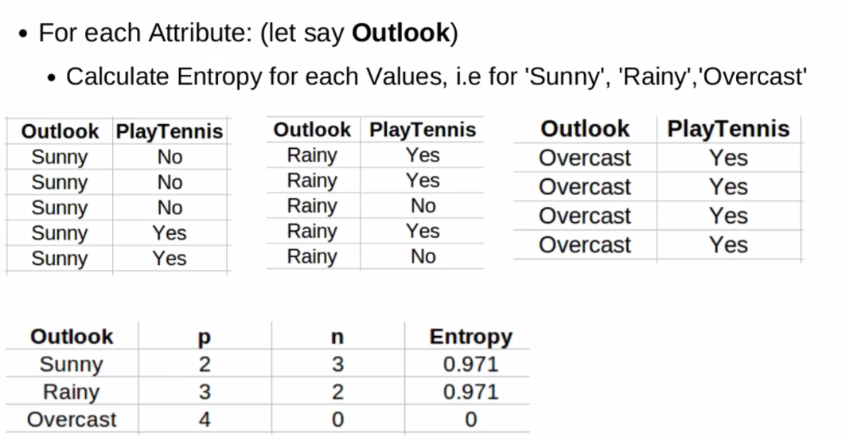
Example- DECISION TREES

Slide 24
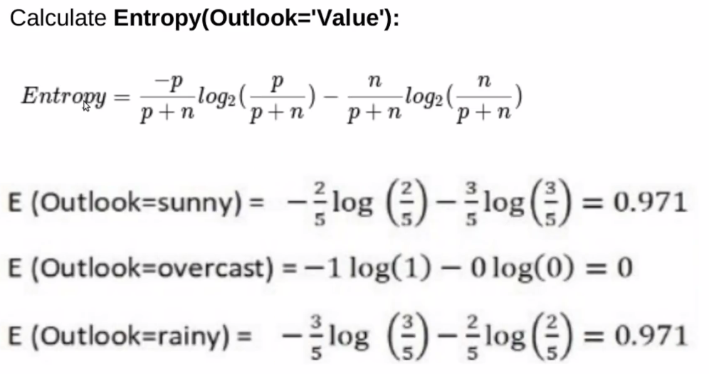
Example- DECISION TREES

Slide 25
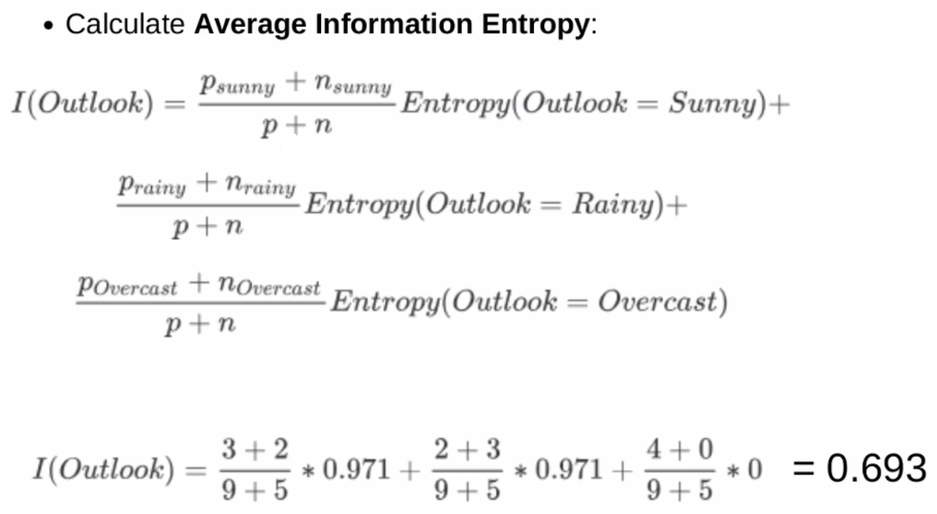
Example- DECISION TREES

Slide 26
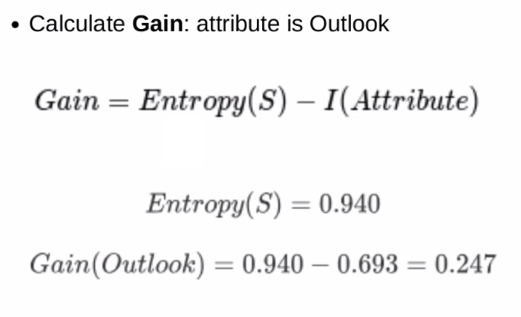
Example- DECISION TREES

Slide 27
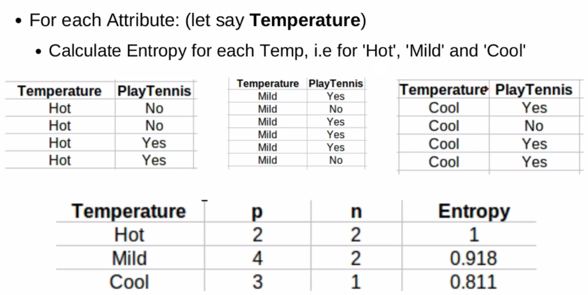
Example- DECISION TREES

Slide 28
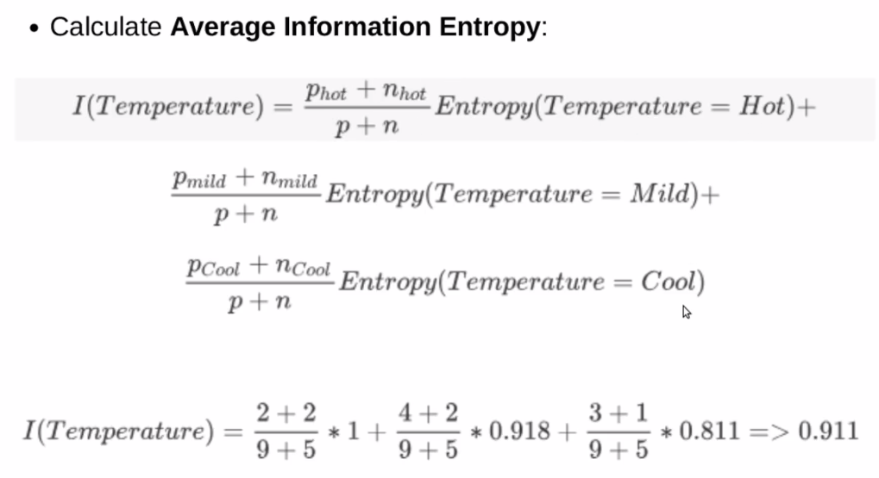
Example- DECISION TREES

Slide 29
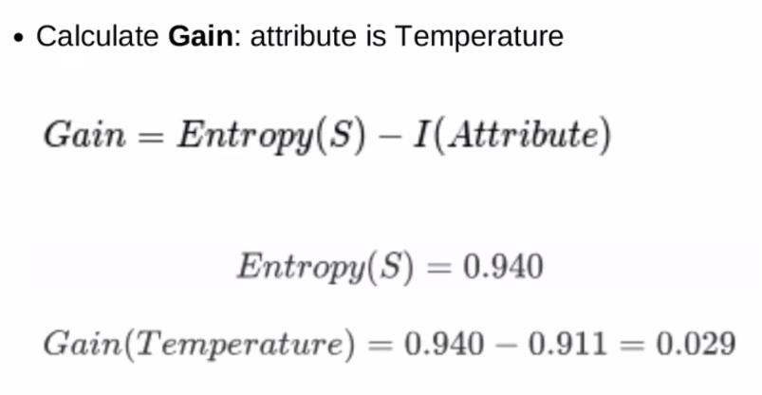
Example- DECISION TREES

Slide 30
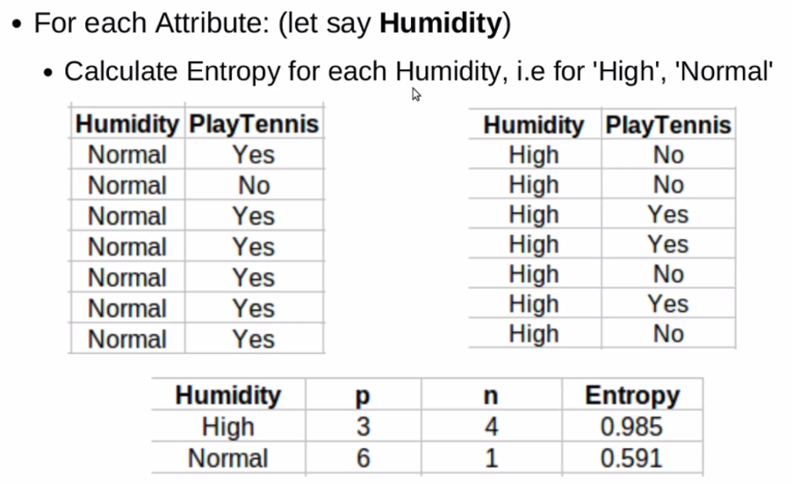
Example- DECISION TREES

Slide 31
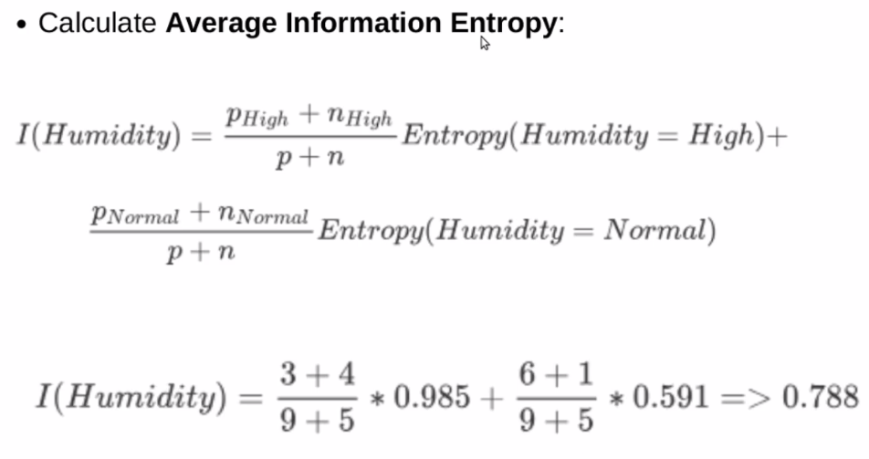
Example- DECISION TREES

Slide 32
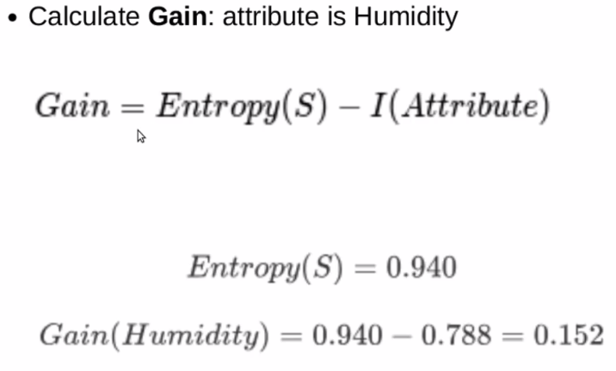
Example- DECISION TREES

Slide 33
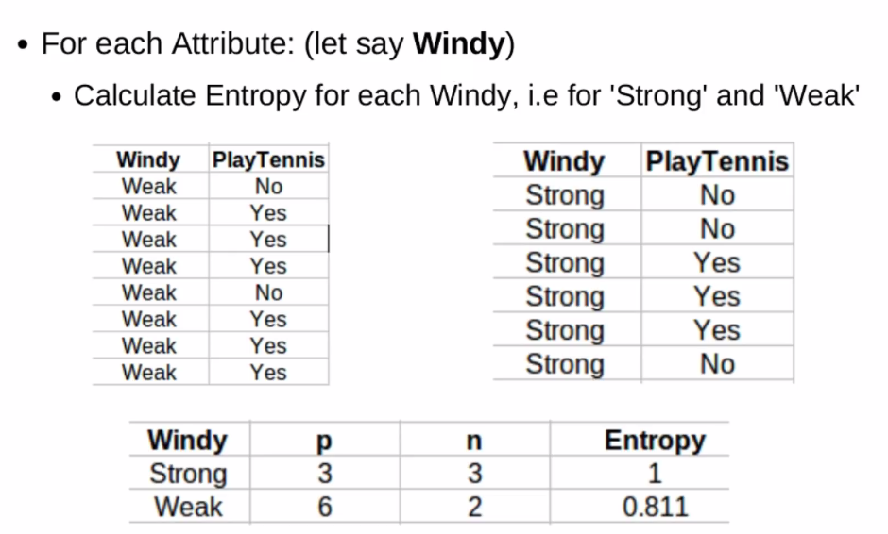
Example- DECISION TREES

Slide 34
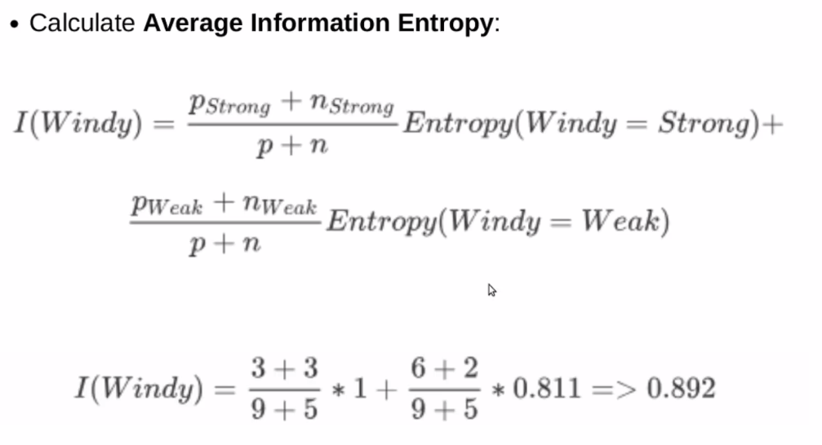
Example- DECISION TREES

Slide 35
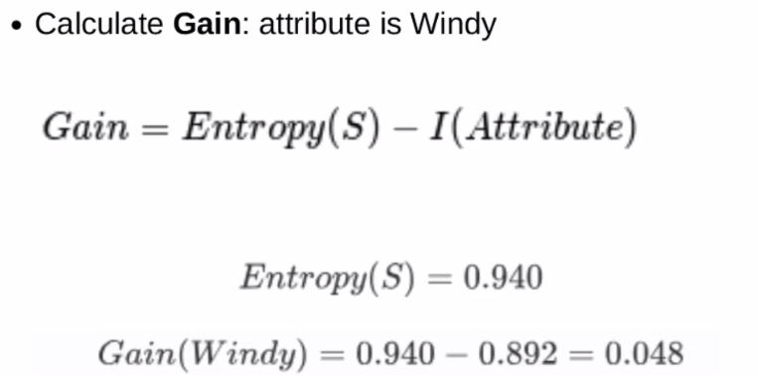
Example- DECISION TREES

Slide 36
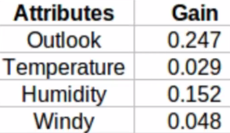
Example- DECISION TREES
Pick the highest Gain Attribute→ Root Node = Outlook

Slide 37
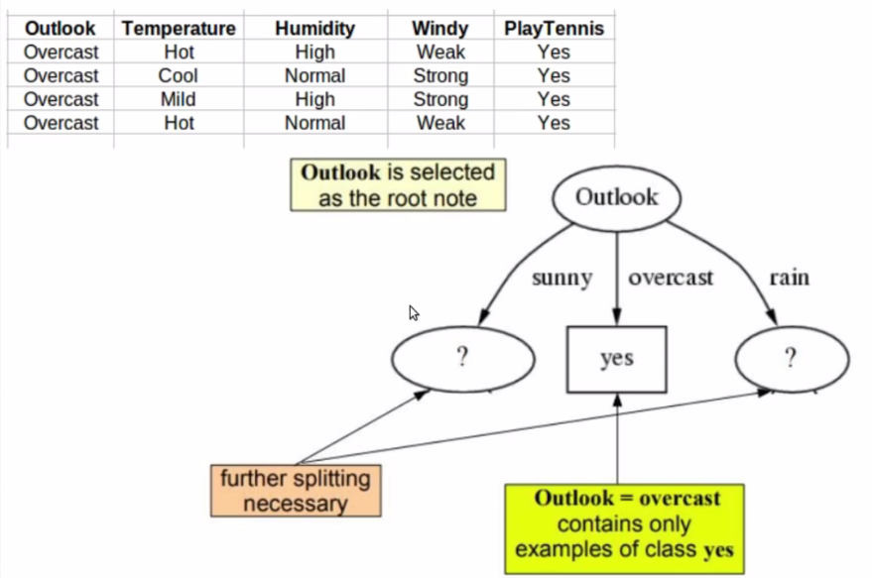
Example- DECISION TREES

Slide 38
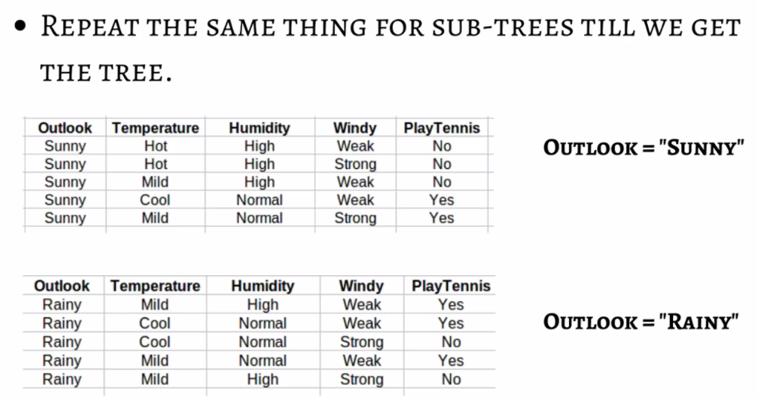
Example- DECISION TREES

Slide 39
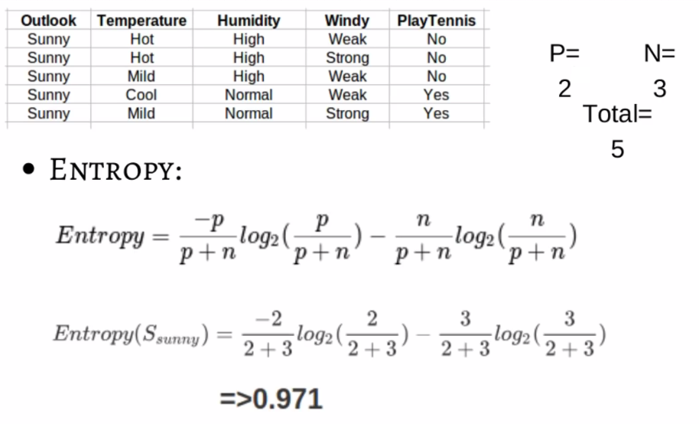
Example- DECISION TREES

Slide 40
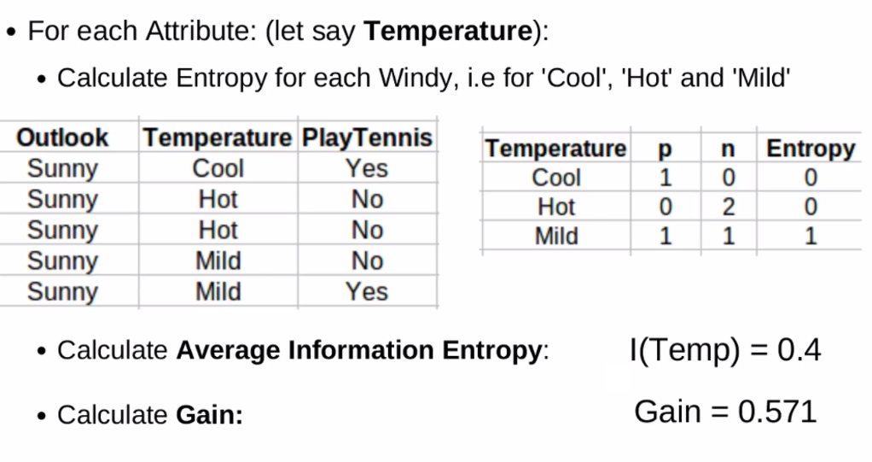
Example- DECISION TREES

Slide 41
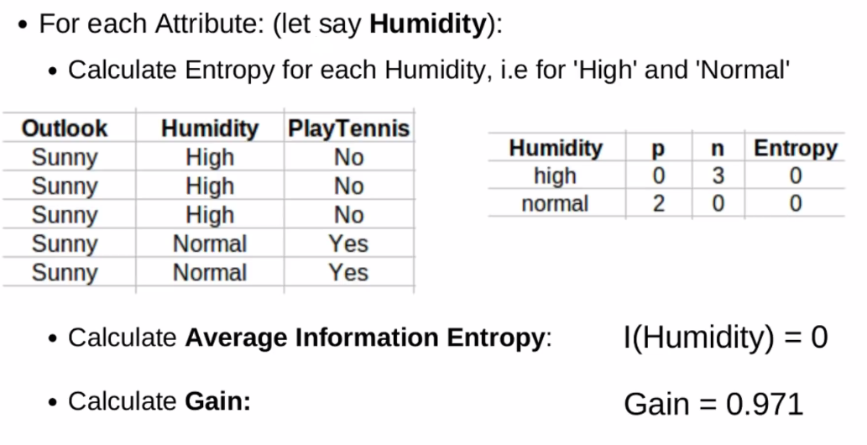
Example- DECISION TREES

Slide 42
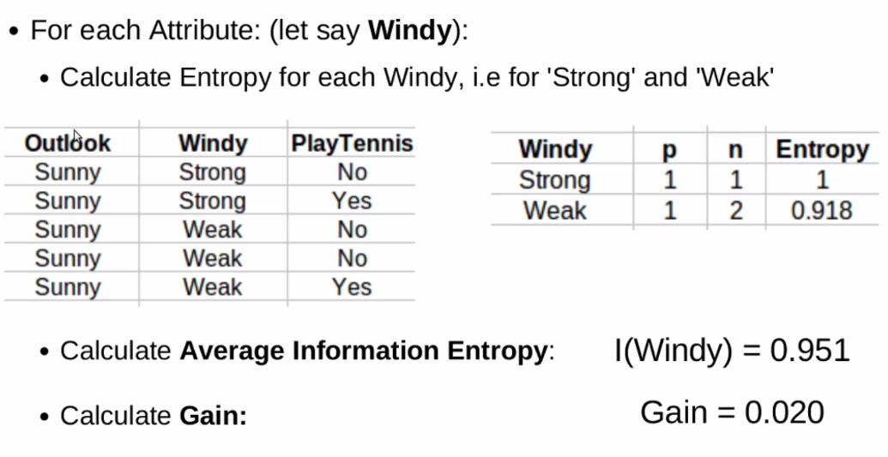
Example- DECISION TREES

Slide 43
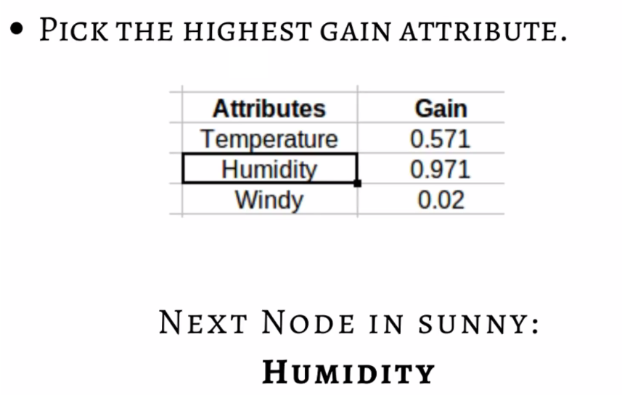
Example- DECISION TREES

Slide 44
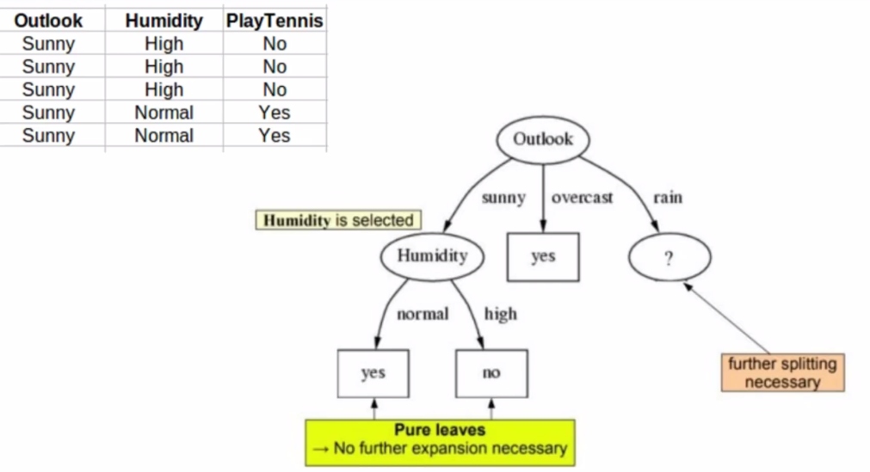
Example- DECISION TREES

Slide 45
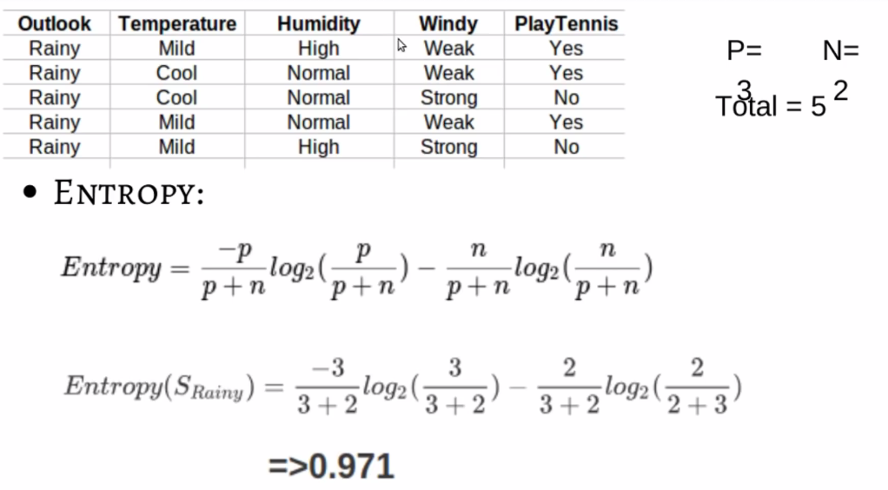
Example- DECISION TREES

Slide 46
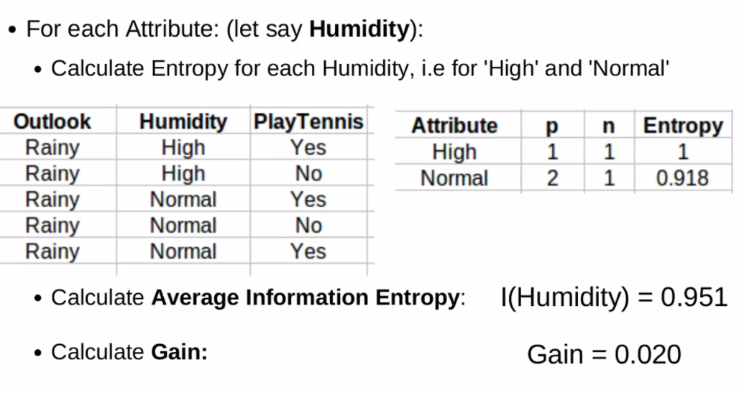
Example- DECISION TREES

Slide 47
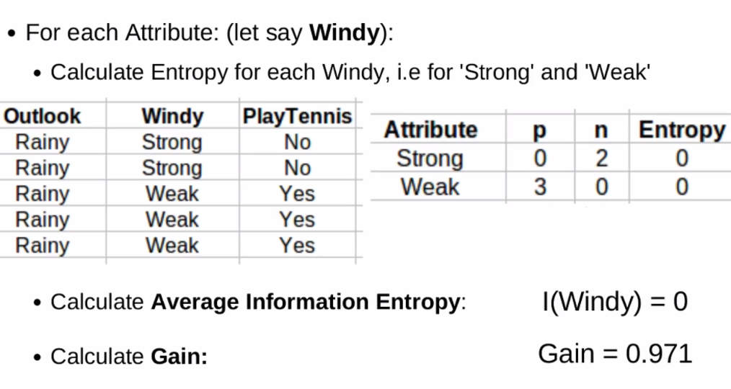
Example- DECISION TREES

Slide 48
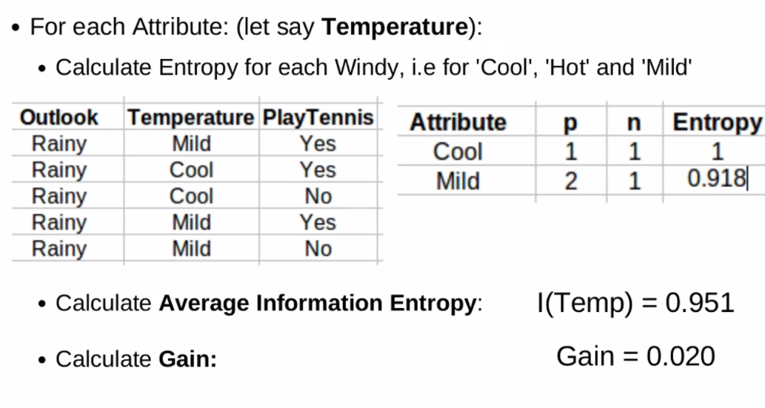
Example- DECISION TREES

Slide 49
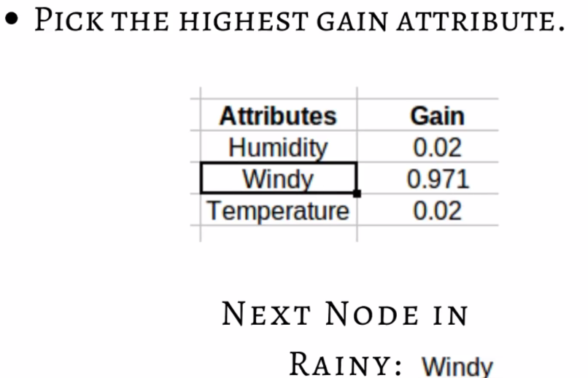
Example- DECISION TREES

Slide 50
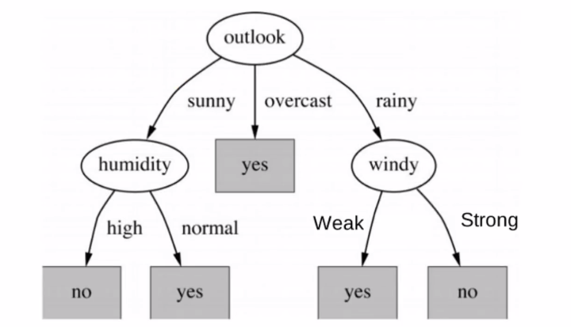
Final Tree for the Example

Slide 51
DECISION TREES
From Decision Trees to Rules
Next Step: Make rules from the decision tree
After making the identification tree, we trace each path from the root node to leaf node, recording the test outcomes as antecedents(past history) and the leaf node classification as the consequent(resultant)
For our example we have:
If the Outlook is Sunny and the Humidity is High then No
If the Outlook is Sunny and the Humidity is Normal then Yes
...

Slide 52
DECISION TREES
ID3 performs no backtracking, therefore it is susceptible to converging to locally optimal solutions
ID3 uses all training examples at each step to refine its current hypothesis. This makes it less sensitive to errors in individual training examples.
However, this requires that all the training examples are present right from the beginning and the learning cannot be done incrementally with time.

Slide 53
Gain Ratio for Attribute Selection
Information gain measure is biased towards attributes with a large number of values
C4.5 (a successor of ID3) uses gain ratio to overcome the problem (normalization to information gain)
  GainRatio(A) = Gain(A)/SplitInfo(A)
Ex.
  Gain_ratio(income) = 0.029/1.557 = 0.019
The attribute with the maximum gain ratio is selected as the splitting attribute

Slide 54
Gini Index (CART, IBM)
If a data set D contains examples from n classes, then gini index (D) is defined as
where p_{j} is the relative frequency of class j in D
If a dataset D is split on A into two subsets D₁ and D₂, the gini index gini(D) is defined as
Reduction in Impurity:

Slide 55
Gini Index (CART, IBM)
The attribute which provides the smallest gini_{split} (D) (or the largest reduction in impurity) is chosen to split the node (need to enumerate all the possible splitting points for each attribute)
The Gini index is used in CART.
It considers a binary split for each attribute.
Let’s first consider the case where A is a discrete-valued attribute having v distinct values.
To determine the best binary split on A, we examine all the possible subsets that can be formed using values of A.

Slide 56
DECISION TREES - CART
Gini index is a metric for classification tasks in CART. It stores sum of squared probabilities of each class. We can formulate it as illustrated below.
Gini(Attribute=Value)
Gini = 1 – Σ (Pi)² for i=1 to number of classes
Then, we will calculate weighted sum of gini indexes for feature.
=Σ Pv *GI(v)
V=Value
Gini(Attribute)

Slide 57
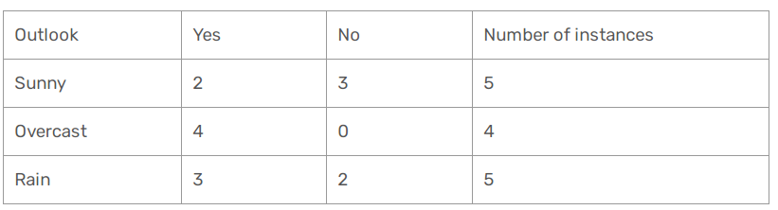
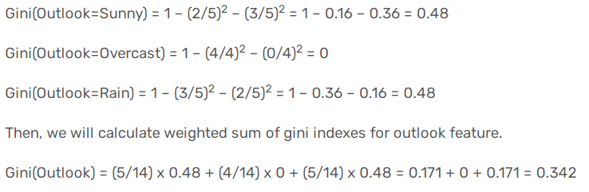
DECISION TREES - CART
OUTLOOK

Slide 58
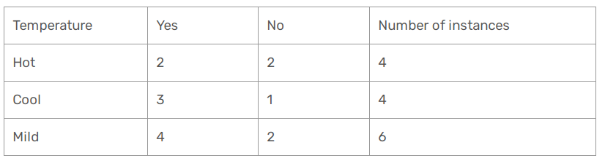
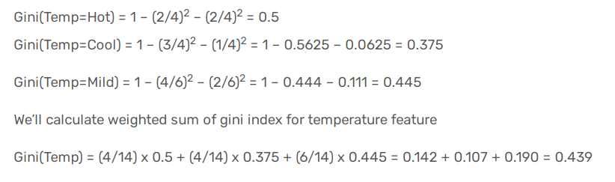
DECISION TREES - CART
TEMPERATURE

Slide 59
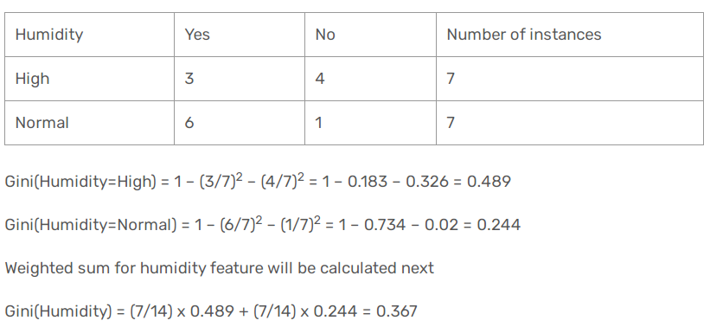
DECISION TREES - CART
Humidity

Slide 60
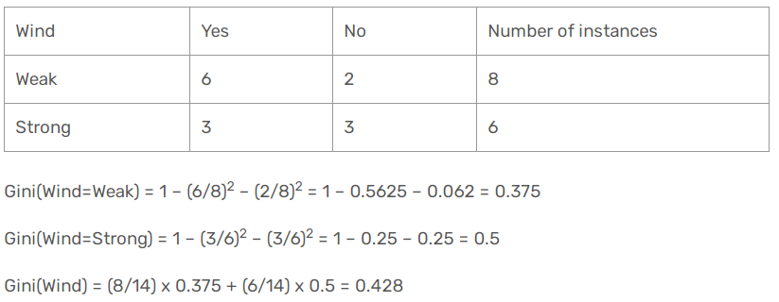
DECISION TREES - CART
WIND

Slide 61
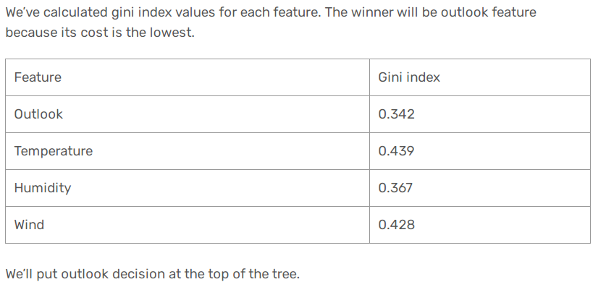
DECISION TREES - CART
DECIDE ROOT NODE ??

Slide 62
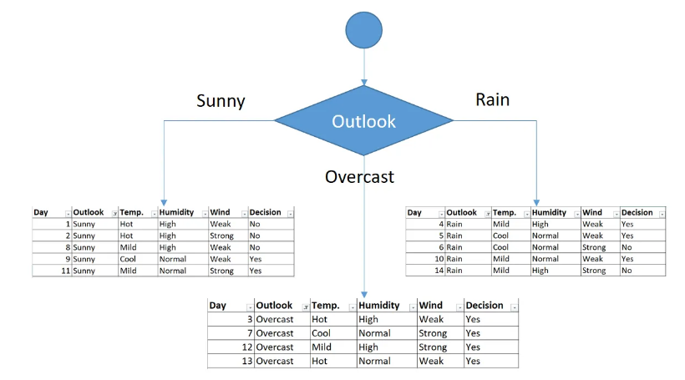
DECISION TREES - CART

Slide 63
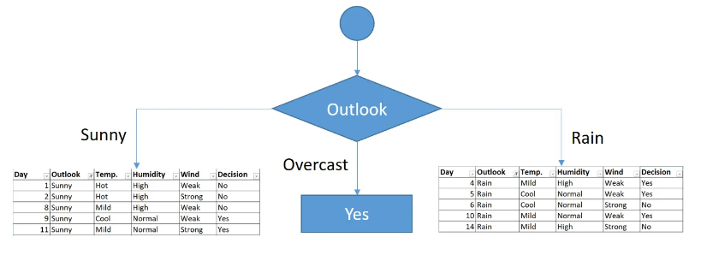
DECISION TREES - CART
You might realize that sub dataset in the overcast leaf has only yes decisions. This means that overcast leaf is over.

Slide 64
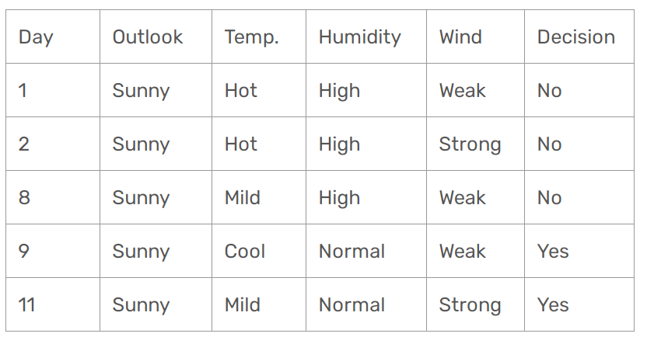
DECISION TREES - CART
Focus on the sub dataset for sunny outlook. We need to find the gini index scores for temperature, humidity and wind features respectively.

Slide 65
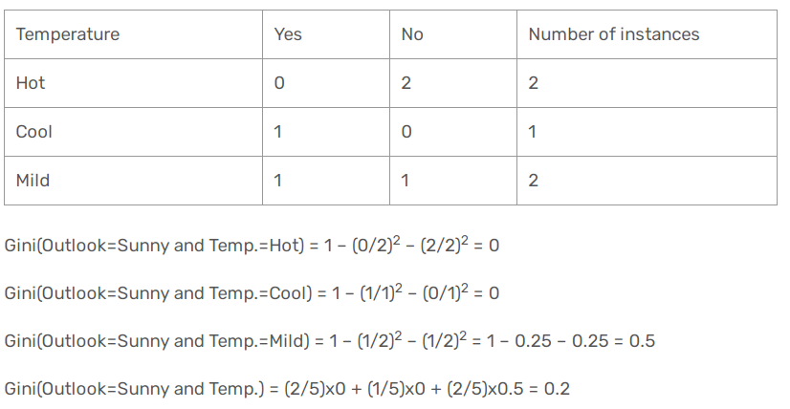
DECISION TREES - CART
Temperature

Slide 66
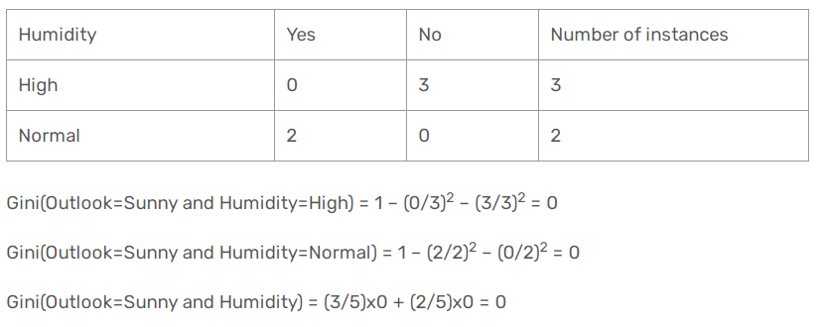
DECISION TREES - CART
Humidity

Slide 67

DECISION TREES - CART
WIND
Gini(Outlook=Sunny and Wind=Weak) = 1 – (1/3)² – (2/3)² = 0.45
Gini(Outlook=Sunny and Wind=Strong) = 1- (1/2)² – (1/2)² = 0.5
Gini(Outlook=Sunny and Wind) = (3/5)x0.45 + (2/5)x0.5 = 0.466

Slide 68

DECISION TREES - CART
Decision for Sunny Outlook ? ?

Slide 69

DECISION TREES - CART
As seen, decision is always no for high humidity and sunny outlook. On the other hand, decision will always be yes for normal humidity and sunny outlook. This branch is over.

Slide 70

DECISION TREES - CART
As seen, decision is always no for high humidity and sunny outlook. On the other hand, decision will always be yes for normal humidity and sunny outlook. This branch is over.

Slide 71

DECISION TREES - CART
RAIN Outlook

Slide 72

DECISION TREES - CART
Temperature

Slide 73

DECISION TREES - CART
Humidity

Slide 74

DECISION TREES - CART
Wind

Slide 75

DECISION TREES - CART
Decision for Rain Outlook ??

Slide 76

DECISION TREES - CART

Slide 77

DECISION TREES - CART

Slide 78
Comparing Attribute Selection Measures
The three measures, in general, return good results but
  Information gain:
    Biased towards multivalued attributes
  Gain ratio:
    Tends to prefer unbalanced splits in which one partition is much smaller than the others
  Gini index:
    Biased to multivalued attributes
    Has difficulty when # of classes is large
    Tends to favor tests that result in equal-sized partitions and purity in both partitions

Slide 79
DECISION TREES
Decision Trees: Issues in Learning
Practical issues in learning decision trees include:
  How deeply to grow the decision tree
  Handling continuous attributes
  Choosing an appropriate attribute selection measure
  Handling training data with missing attribute values
  Handling attributes with differing costs

Slide 80
Thanks!!!
Reach out with any questions on MSTeams
Email a.mahmood3@uel.ac.uk

